Slide 1
Family Violence Information Sharing Session 5 – What I need to know to keep records about family violence information sharing

Slide 2
Session agenda
Session 5
Reflection on Session 4
Objective and learning outcomes
What I need to know to keep records about family violence information sharing
Activity & case study – Making a record of a family violence information sharing request using a case study
Resources
Agenda

Slide 3
Reflection on Session 4

Slide 4
Reflections on Session 4
Session 5
Activity
Recap of last session’s activity
Role playing the process of requesting information under the Family Violence Information Sharing Scheme.
Take some time to think back on your experience…
What was your experience like of practising making a family violence information sharing request?
Was it easy or difficult to figure out which information you needed to have organised before making a request?
Would you feel confident making a request if you were to come across family violence risk relevant information now?

Slide 5
Objectives and learning outcomes

Slide 6
Objectives
Session 5
Info
Understand what information needs to be recorded when responding to a request to share family violence information.
Run through your organisation’s processes for recording a response to a request to share family violence information.

Slide 7
Learning outcomes
Session 5
At the end of this session you will be able to:
Explain why it’s important to record your actions and any information you share after receiving a family violence information sharing request.
Know the process for recording information within your organisation.
Know where to locate resources that help you to complete record keeping requirements.

Slide 8
What I need to know to keep records about family violence information sharing

Slide 9
What I need to know to keep records about family violence information sharing
Session 5
Info
When do I need to keep records?
Under regulations, you are required to keep records every time:
you receive a family violence information sharing request
you share family violence information proactively.
It is also good practice to keep records of when you make a family violence information sharing request or receiving family violence information that has been proactively shared with you.
Record keeping is important because it allows us to understand what family violence information has been shared, why it was shared and with who. This helps us ensure family violence information is being shared in a safe and appropriate way.

Slide 10
What I need to know to keep records about family violence information sharing
Session 5
When you receive any request, you must record:
The ISE that made the request
The date of the request
Request refused
Record the reason that the request has been refused.
Advise the requestor in writing the reason for the refusal.
Activity
Record complete
Request granted
NOTE: This is a detailed aid for the information you need to record based on different scenarios.
You will only ever need to complete 3 boxes at any one recording!
Record the following information:
Who you are sharing the family violence information with (organisation and person)
How the family violence information was shared, and if via email, whether there was encryption
Who the family violence information is being shared about (e.g. adult victim survivor, child, perpetrator, third party)
How it was determined the threshold to share family violence information was met
The family violence information that was disclosed
The date on which the family violence information was disclosed
Risk relevant information or safety plans that have been prepared for the person at risk of family violence
Does the information involve a child? Note: Information involving a child includes:
An adult victim survivor or third party (where a child is at risk),
a child’s parent,
a child victim survivor
No
Is the information about an adult victim survivor or third party and no children are at risk?
No further action. Record complete
No
Yes
Record:
That consent was not provided
Why no consent was provided
If the person was informed that their information was shared without consent
Was consent given?
No
Yes
Were their views (or those of their parents) sought about sharing information?
Yes
Yes
No
Record:
That consent was provided
How consent was given (e.g. written, verbal or implied)
Record:
That views about sharing information were sought
If they (the child or parent) were informed that their information was disclosed
Record:
That views about sharing information were not sought
The reason why views weren’t sought
If they were informed that their information was disclosed
Record complete
Record complete

Slide 11
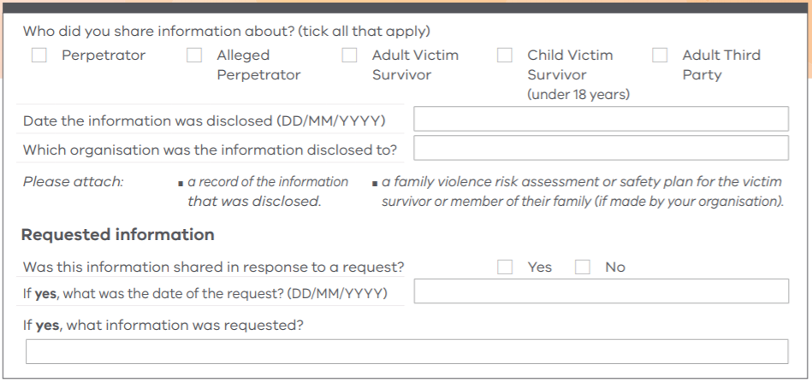
What I need to know to keep records about family violence information sharing
Session 5
Info
Where and how do I record this information?
Your organisation will have its own process for record keeping. It’s important to confirm what this is and keep records in line with this.
The example below provides an overview of the types of things that should be recorded.

Slide 12
Activity

Slide 13
How do I record details about family violence information sharing?
Session 5
Activity
Making sure you are familiar with how to record details about family violence information sharing, will make it easier to follow through when you need to record them.

Slide 14
How do I record details about family violence information sharing?
Session 5
Activity
Practice the steps for recording details about family violence information sharing.
This will be a group activity so that everyone is familiar with our organisation’s processes for record keeping.
Step 1
<Insert description of first step in the process.>
Tip: <Include any tips for how to complete this step here. Otherwise delete this purple text>.
Step 2
<Insert description of second step in the process.>
)
Tip: <Include any tips for how to complete this step here. Otherwise delete this purple text>.
Step 3
<Insert description of third step in the process. Delete this box if not needed.>
)
Tip: <Include any tips for how to complete this step here. Otherwise delete this purple text>.
!
This is a template slide for team leaders to complete before presenting to their teams.
To show your teams about what your organisation’s record keeping processes are, we suggest mapping out what steps are required on this slide and the following slides.
Delete this red box before presenting to your team.

Slide 15
How do I record details about family violence information sharing?
Session 5
Activity
Step 4
<Insert description of third step in the process. Delete this box if not needed.>
Tip: <Include any tips for how to complete this step here. Otherwise delete this purple text>.
Step 5
<Insert description of third step in the process. Delete this box if not needed.>
Tip: <Include any tips for how to complete this step here. Otherwise delete this purple text>.
Step 6
<Insert description of third step in the process. Delete this box if not needed. Copy this slide if there are more steps.>
Tip: <Include any tips for how to complete this step here. Otherwise delete this purple text>.
Tip: <Include any overarching tips for how to complete this process here. Otherwise delete this box>.
!
This is a template slide for team leaders to complete before presenting to their teams. This slide follows on from the previous slide in case a second steps slide is required to show how record keeping should be done in your organisation.
Create more slides if you need more than the two slides provided here.
Delete this red box before presenting to your team.

Slide 16
Resources

Slide 17
Organisation-specific resources
Session 3
Some useful internal resources are provided below. Try to visit each of them over the next week, so you are aware of what internal policies and procedures exist to support family violence information sharing.
Info
Resource name:
<Insert resource name here>
How it helps:
<Insert brief description about why this resource is helpful>
Location:
<Insert instructions or a link to access this resource>
<Include an image of the location or the resource>
Resource name:
<Insert resource name here>
How it helps:
<Insert brief description about why this resource is helpful>
Location:
<Insert instructions or a link to access this resource>
<Include an image of the location or the resource>

Slide 18
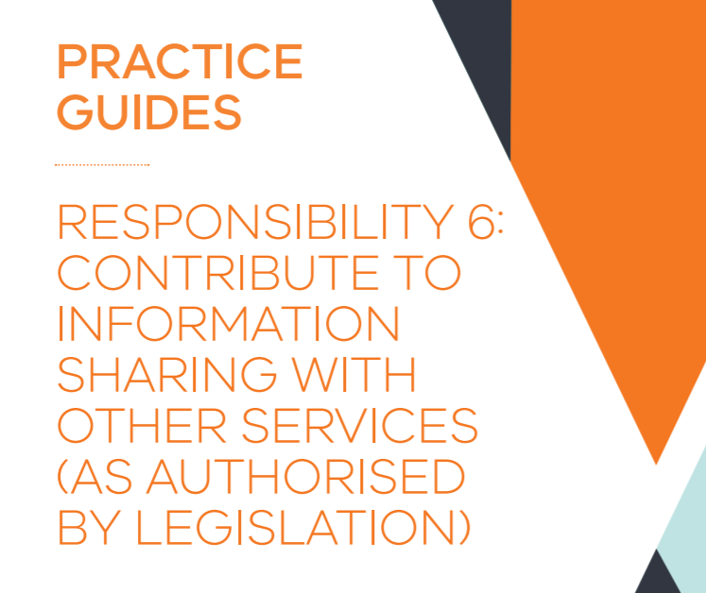
General resources
Session 4
Some additional resources are provided below. Try and familiarise yourself with them, so that you are aware of what additional information exists to support you as you adapt to the Family Violence Information Sharing Scheme.
Info
Resource name:
Tips for Information Sharing Record Keeping
How it helps: Provides further information about how to approach record keeping.
Location:
https://www.vic.gov.au/sites/default/files/2020-02/Tips-for-information-sharing-record-keeping.pdf
Resource name:
MARAM Practice Guidance: Information Sharing with other services (section 6.7.3)
How it helps: Comprehensive practice guidance about the family violence information sharing responsibility under MARAM
Location: https://www.vic.gov.au/sites/default/files/2020-05/PG%20Responsibility%206.pdf

