Slide 1


Family Violence Information Sharing
Session 4 – How do I make a family violence information sharing request?

Slide 2






Session agenda
Session 4
Reflection on Session 3
Objectives and learning outcomes
How to make a family violence information sharing request
Activity – Practise the steps for making a request
Resources
Agenda

Slide 3
Reflection on Session 3

Slide 4



Reflection on Session 3
Session 4
Activity
Recap of last session’s activity
Using a scenario to think about when it's appropriate to share family violence information and what consent is required.
Take some time to think back on your experience…
How confident do you feel determining whether the purpose of family violence information sharing is for protection or assessment purposes?
Do you remember what to do if you're ever unsure about whether to share family violence information?

Slide 5
Objectives and learning outcomes

Slide 6








Objectives
Session 4
Info
Understand why you would need to make a family violence information sharing request as part of your work.
Practise the steps for making a family violence information sharing request.

Slide 7
Learning outcomes
Session 4
At the end of this session you will be able to:
Explain when you would need to make a family violence information sharing request, or who to ask if you're not sure.
Apply the steps involved in making a family violence information sharing request.
Know where to locate resources to check the steps involved in making a family violence information sharing request.

Slide 8
How to make a family violence information sharing request

Slide 9

How to make a family violence information sharing request
Session 4
Info
We share and request information to assess and manage risk to victim survivors of family violence, with the ultimate goal of increasing their safety.
You can request family violence information from other organisations that helps you assess and manage risks to victim survivors, including when your client is the perpetrator of family violence.
Who can make requests for family violence information?
Information Sharing Entities prescribed by regulations.
You and your organisation are included.
When to request family violence information?
If you identify risk relevant information in the course of your work, then you should consider what further information you may need from other services to help you assess and manage that risk.
Remember!
Risk relevant information is about family violence behaviours and the circumstances in which those behaviours occur (risk factors), stabilisation or recovery from family violence (protective factors) as well as information about a perpetrator’s stabilisation (stabilisation factors).

Slide 10
How to make a family violence information sharing request
Session 4
Info
Note that family violence information sharing does not always have to be a formal process. If you frequently engage with and share family violence information with another service, you’ll find that these steps become intuitive. As you get used to family violence information sharing, it should become a standard part of your work practice.
The full details of what to consider when making a request can be found on the Information sharing process checklist. We suggest printing it out or saving it somewhere handy on your computer for easy access when you are making a request.
Step 1 – Decide what type of risk relevant information you need in order to assess and manage family violence risk and determine which organisation might hold that information.
For example, if you’ve recently been made aware about a Family Violence Intervention Order, you may need to make a request to Victoria Police or the Courts.
Step 2 – Check the organisation you are requesting family violence information from is an Information Sharing Entity (ISE). You can only request family violence information from an ISE.
Tip – Remember we covered how to check the ISE List in Session 1.

Slide 11
How to make a family violence information sharing request
Session 4
Info
Step 3 – Decide whether it’s better to make the request verbally or in writing.
Verbal requests work well if you already know the contact/organisation.
Written requests are a good option if you don’t have a relationship with the organisation. You may wish to consider sending these from your organisation’s official email account, to help the recipient verify you are an ISE.
Step 4 – Ask yourself whether you are requesting family violence information for a permitted purpose:
Family violence assessment purpose: This is about identifying who the ‘actual’ perpetrator and victim survivor are, and establishing the level of risk the perpetrator poses to the victim survivor.
  Note - Only prescribed Risk Assessment Entities are entitled to make requests for assessment purposes, so you’ll also need to check if the organisation is a Risk Assessment Entity using the ISE List (not all ISEs are Risk Assessment Entities).
Family violence protection purpose: This is about managing the risk of a perpetrator committing family violence or the victim survivor being subjected to family violence.
  Note - Any prescribed ISE can request and share family violence information for protection purposes.

Slide 12
How to make a family violence information sharing request
Session 4
Info
Step 5 – Make the request, remembering to:
Clearly identify the purpose of your call or email and why you believe they may hold relevant information.
Share sufficient information to enable the ISE to determine whether they can agree to your request. Think about what you would need to decide whether to share information, as we covered in Session 3.
Give precedence to a victim survivor’s right to be safe.
Step 6 – It is important that you document the information sharing request, noting down:
The service you contacted and the worker you spoke with.
The information that was disclosed.
Any risk assessment or safety plan made as a result of information sharing.
If your request was refused.

Slide 13
Activity

Slide 14




Prepare and practice making your own family violence information sharing request
Session 4
Activity
Practising the family violence information sharing request process builds confidence for when we need to request information from other ISEs

Slide 15


Prepare and practice making your own family violence information request
Session 4
Activity
Step 1
Get into groups of two.
Step 2
In your pairs allocate yourself to either Person A or Person B.
Step 3
On the next slide, there are two case studies. Take 5 minutes to read your case study.
Person A should read case study A
Person B should read case study B
Step 4
Before you discuss with your partner, think about your case study and list down the following points that would help you make your family violence information sharing request:
What information do you need to assess and / or manage the risk to your client?
Who would you make the information request to (noting there may be multiple)?
How have you determined if your client is a perpetrator or victim survivor of family violence?
Do you need consent? Have you sought consent or the views of the client?
Note down a brief summary of what you would say to the organisation you are requesting information from, to explain why you are asking for information under the Family Violence Information Sharing Scheme?
Note down if this request is to a central unit, an unknown service or a service that you already have a relationship with.
TIP: Use the making a request checklist to help with the information you need to provide.

Slide 16
Prepare and practice making your own family violence information request
Session 4
Activity
Case study A
Imagine you are in an intake and assessment role within your organisation.
In this role, you’ve received a referral for a client for substance use support. The referral came from a mental health service. When you received the referral over the phone it was stated that the client had recently assaulted their partner.
While doing the initial intake and assessment you discover that your client has two children who are living at home with them and their partner. Your client had also admitted to using violence against their partner recently during an argument they had.
Case study B
Imagine you are an AOD clinician within your organisation. You have started counselling a new client after they sought support following the loss of their job, because of their alcohol and drug behaviour. In an early session, the client told you that they are also having relationship issues at home. One of the things they raised about the relationship is that they feel trapped by the financial allowance their partner gives them, and that this allowance has decreased since they lost their job.
In a later session with the client, you learn that they have been having verbal disagreements with their partner about money, alcohol and drug use. They have also had disagreements about the temporary housing they are staying in. They tell you that the most recent disagreement involved a lot of alcohol and led to violence. They tell you that this isn’t the first time and that they have seen a family violence service before.
You know that there are no children in this relationship.
Case study B was adapted from material originally developed by the Eastern Metropolitan Regional Family Violence Partnership.

Slide 17
Prepare and practice making your own family violence information request
Session 4
Activity
Do these steps in your pairs
Step 5
In your pairs:
Take turns to explain the circumstance in your case study
Outline what you would do to make a family violence information sharing request.
Step 6
After each having a turn:
Give each other feedback on the way you approached the information sharing request,
Discuss any other steps that could also be taken.
Step 7
Discuss with your partner:
The type of information you might expect to receive following the information request,
How you would use this to manage risk for the victim survivor in your scenario.
TIP: Refer to the notes you made in the previous step and any other resources that you would use (such as the making a request checklist).
TIP: Think about:
If there were any other people who could have been contacted (either in your own organisation or outside of it),
What other pieces of information would have helped with the request,
How any new information would be used to manage the safety of the victim survivor.

Slide 18
Prepare and practice making your own family violence information request
Session 4
Activity
Group discussion
What did you find easy or difficult about that exercise?
What would you do differently about making family violence information requests in the future?

Slide 19
Resources

Slide 20

Organisation-specific resources
Session 4
Some useful internal resources are provided below. Try to visit each of them over the next week, so you are aware of what internal policies and procedures exist to support family violence information sharing.
Info
Resource name:
<Insert resource name here>
How it helps:
<Insert brief description about why this resource is helpful>
Location:
<Insert instructions or a link to access this resource>
<Include an image of the location or the resource>
Resource name:
<Insert resource name here>
How it helps:
<Insert brief description about why this resource is helpful>
Location:
<Insert instructions or a link to access this resource>
<Include an image of the location or the resource>

Slide 21
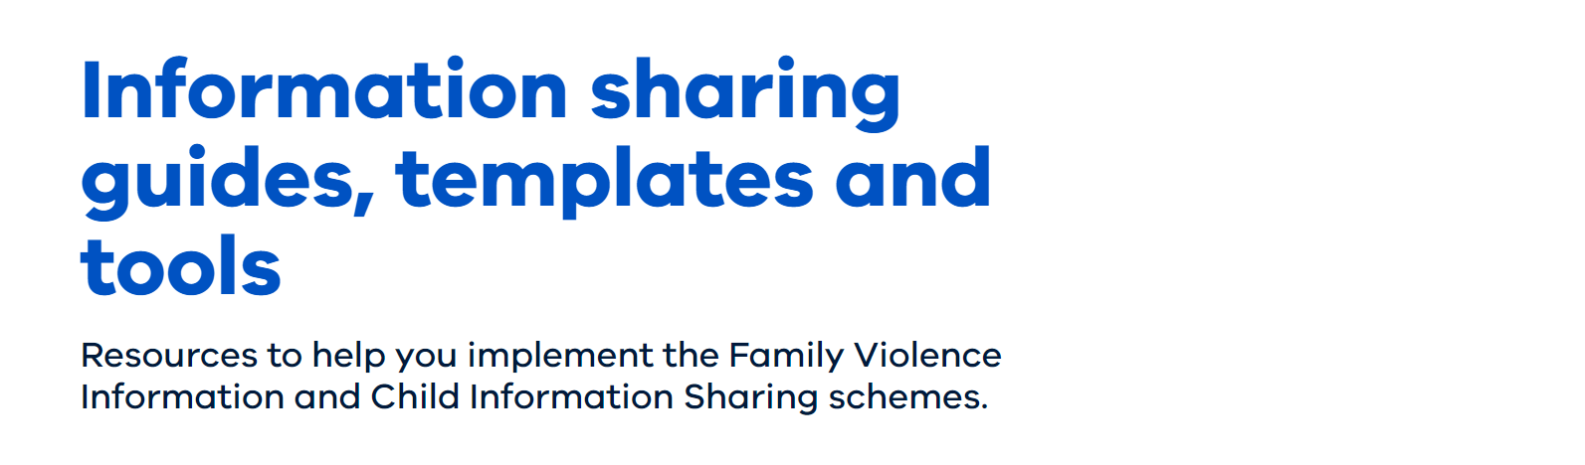

General resources
Session 4
Some additional resources are provided below. Try and familiarise yourself with them, so that you are aware of what additional information exists to support you as you adapt to the Family Violence Information Sharing Scheme.
Info
Resource name:
Information sharing guides, templates and tools – Section 5 “Request information”
How it helps: The public resource page for information sharing guides, templates and tools. Section 5 has specific resources for making information sharing requests.
Location::
https://www.vic.gov.au/guides-templates-tools-for-information-sharing
Resource name:
How to request information under the Family Violence Information Sharing Scheme
How it helps: Lists the exact information you need to have prepared in order to make a good information request
Location: https://www.vic.gov.au/sites/default/files/2020-01/How-to-request-information-under-the-Family-Violence-Information-Sharing-Scheme.DOCX

Slide 22

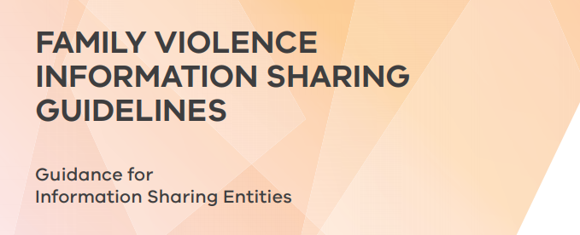
General resources
Session 4
Some additional resources are provided below. Try and familiarise yourself with them, so that you are aware of what additional information exists to support you as you adapt to the Family Violence Information Sharing Scheme.
Info
Resource name:
Information sharing process checklist when making a request
How it helps: A concise list of things to remember when making a family violence information sharing request.
Location:
https://www.vic.gov.au/sites/default/files/2020-01/Information-sharing-process-checklist-when-making-a-request.PDF
Resource name:
Family Violence Information Sharing Guidelines
How it helps: The complete guidelines for family violence information sharing. A helpful reference as the checklist for making information sharing requests guides you to review pages 84 and 90 in this document.
Location:
https://www.vic.gov.au/sites/default/files/2019-01/Ministerial%20Guidelines%20-%20Family%20Violence%20Information%20Sharing%20Scheme.pdf
Updated to here

