Slide 1


Family Violence Information Sharing
Session 2 – How do I discuss family violence information sharing requirements with my clients?

Slide 2







Session agenda
Session 2
Reflection on Session 1
Objectives and learning outcomes
Risk relevant information and discussing family violence information sharing with clients
Activity – Introducing family violence information sharing with clients
Case study and discussion – Identifying risk relevant information
Resources
Agenda

Slide 3
Reflection on Session 1

Slide 4



Reflection on Session 1
Session 2
Activity
Recap of last session’s activity
Use the Information Sharing Entity (ISE) List to search for organisations you frequently interact with.
Take some time to think back on your experience…
What organisations did you find on the list?
When would you use this list in future?
What tips would you share with others?

Slide 5
Objectives and learning outcomes

Slide 6








Objectives
Session 2
Info
Understand what risk relevant information is for the Family Violence Information Sharing Scheme.
Practise client conversations about when their information can be shared under this scheme.

Slide 7
Learning outcomes
Session 2
At the end of this session you will be able to:
Explain what risk relevant information is.
Explain your role in identifying risk relevant information for the assessment and management of family violence risk.
Know where to locate resources that will help you to:
  Have conversations with your clients about family violence information sharing.
  Identify when consent is, and isn’t, needed in order to share family violence information.

Slide 8
Risk relevant information and discussing family violence information sharing with clients

Slide 9

Risk relevant information and client conversations
Session 2
Info
Knowing how and why family violence information is shared helps us have honest conversations.
Honest conversations help us build trust by creating transparency about how and why information might be shared.
Who can share family violence information?
Information Sharing Entities are prescribed by regulations.
You and your organisation are included.
Why do organisations share family violence information?
To assess and manage family violence risk, with the ultimate goal of increasing the safety and wellbeing of adult and children victim survivors.

Slide 10
Risk relevant information and client conversations
Session 2
Info
When should organisations share family violence information?
Voluntarily to another ISE or if another ISE requests the family violence information.
What information can be shared?
Information that is relevant to establish, assess or manage family violence risk under MARAM. We call this risk relevant information.
What is risk relevant information?
Information about family violence behaviours or the circumstances in which that behaviour is occurring (risk factors), stabilisation or recovery from family violence (protective factors) as well as information about a perpetrator’s stabilisation (stabilisation factors).
What information cannot be shared?
If the sharing of information could reasonably be expected to result in endangering a person’s life, lead to physical injury, prejudice legal proceedings or police investigations or contravene a court order, it cannot be shared.
Information also cannot be shared if it is subject to legal professional privilege or contravenes another sharing law.

Slide 11
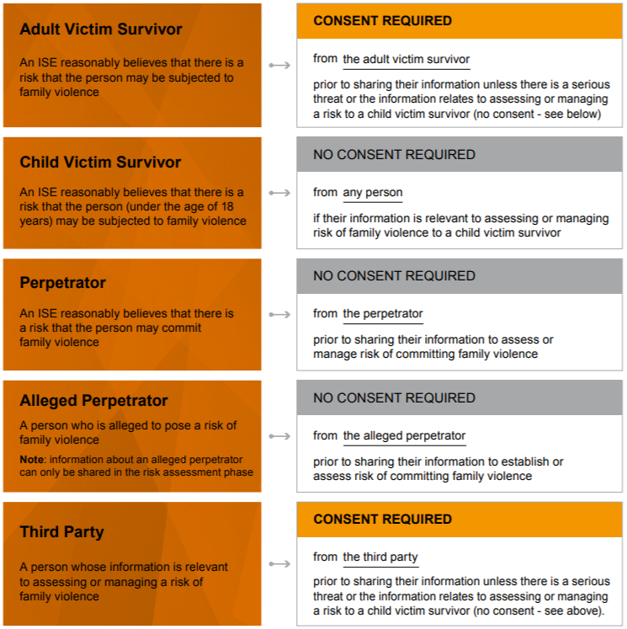
Risk relevant information and client conversations
Session 2
Info
When consent is and isn’t required in order to share risk relevant information

Slide 12
Activity

Slide 13




How do I discuss family violence information sharing requirements with my clients?
Session 2
Activity
Communicating about family violence information sharing with our clients is an important part of building trust.

Slide 14



How do I discuss family violence information sharing requirements with my clients?
Session 2
Activity
Practice having a conversation with your client about family violence information sharing and why it’s important.
Step 1
Get into groups of two or three people.
Step 2
Each spend 10 minutes preparing what you want to say.
Step 3
Take turns role playing:
Yourself having the conversation with a client.
The client.
If you are in a group of three, the third person can observe and provide feedback.
TIP: Use your notes to provide prompts on how you’d like to structure this conversation.
TIP: If you’re role playing the client, think of questions that would be suitable in this interaction to replicate a real client interaction.
TIP: : You can review tips about having a conversation with a child and/or their parents.
TIP: Spend some time at the end of each person’s turn to provide some constructive feedback on how the conversations went.

Slide 15
How do I discuss family violence information sharing requirements with my clients?
Session 2
Activity
Group discussion
What did you find easy or difficult about that exercise?

Slide 16
Case study

Slide 17

What is risk relevant information?
Session 2
Info
The situation:
A referral was received by an Alcohol and Other Drug (AOD) intake and assessment practitioner. During intake, the client disclosed that her partner is homeless as a result of a Family Violence Intervention Order (FVIO) she obtained, which excluded him from their home three weeks ago.
How the family violence information sharing process was used:
An information sharing request to Victoria Police was completed with the client's consent by the AOD practitioner under the Family Violence Information Sharing Scheme.
Information was received from Victoria Police through this request, which identified a long history of offending behaviour including historical family violence against previous partners and the client, including recent incidents (i.e. within the last 5 weeks). The details of the information included;
  Persistent breaches to the current FVIO.
  Charges of stalking and persistent contact (up to 60 calls a day).
  A narrative reporting that the victim survivor felt ‘suffocated’ and terrorised by the ongoing behaviour of the person using family violence.
Based on this information, the assessment of family violence risk was identified as ‘serious.’
An intermediate risk assessment was completed within the same week by the AOD practitioner. It was identified at this point that there were no other services involved to support the victim survivor in relation to the continued family violence. Referral opportunities were explored with the client, and the client agreed to a referral to a Specialist Family Violence Service.
The AOD practitioner consulted with the Specialist Family Violence Advisor and made a referral.
The AOD practitioner obtained the client's consent to the ongoing sharing of risk relevant information obtained through AOD sessions about family violence risk with the Specialist Family Violence Service.
The outcome:
The AOD practitioner continued to work with the client in respect of her AOD use, whilst supporting her with her ongoing family violence risk. With the client's consent, the AOD practitioner shared risk relevant information with Victoria Police and the Specialist Family Violence Service. It supported the client to address her treatment outcomes, while also supporting her psychosocial needs.

Slide 18
What is risk relevant information?
Session 2
Activity
Can you identify the risk relevant information in this case study?
How did the risk relevant information change as the situation unfolded?
Have you encountered any similar scenarios with your own clients?

Slide 19
Resources

Slide 20

Organisation-specific resources
Session 3
Some useful internal resources are provided below. Try to visit each of them over the next week, so you are aware of what internal policies and procedures exist to support family violence information sharing.
Info
Resource name:
<Insert resource name here>
How it helps:
<Insert brief description about why this resource is helpful>
Location:
<Insert instructions or a link to access this resource>
<Include an image of the location or the resource>
Resource name:
<Insert resource name here>
How it helps:
<Insert brief description about why this resource is helpful>
Location:
<Insert instructions or a link to access this resource>
<Include an image of the location or the resource>

Slide 21
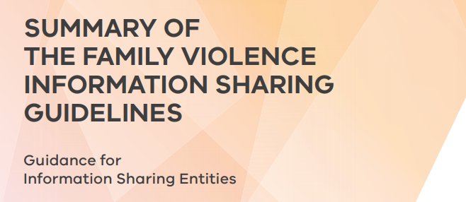
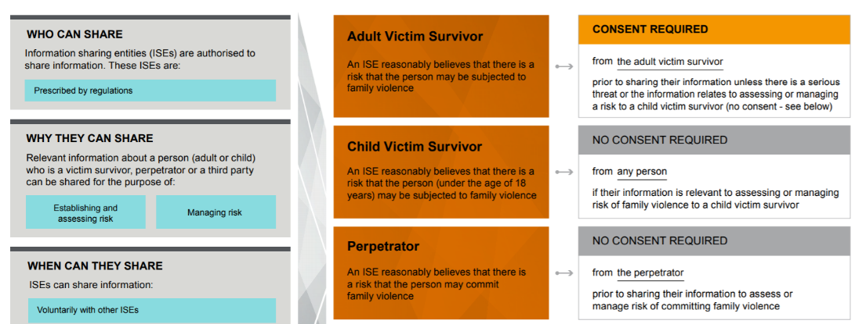
General resources
Session 2
Some additional resources are provided below. Try and familiarise yourself with them, so that you are aware of what additional information exists to support you as you adapt to the Family Violence Information Sharing Scheme.
Info
Resource name:
Overview of the Family Violence Information Sharing Scheme
How it helps: A simple one-page summary of the Family Violence Information Sharing Scheme. This document outlines who should share, why they share information, what information can be shared, when information should be shared and when consent is and isn’t required in order to share.
Location: https://www.vic.gov.au/sites/default/files/2019-11/Overview-of-the-Famiily-Violence-Information-Sharing-Scheme.pdf
Resource name:
Summary of the Family Violence Information Sharing Guidelines
How it helps: Foundational guidelines about family violence information sharing.
Location: https://www.vic.gov.au/sites/default/files/2019-01/Family%20Violence%20Information%20Sharing%20Guidelines%20-%20Summary.pdf

Slide 22
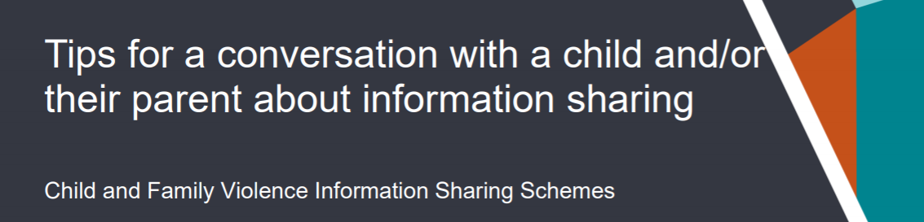
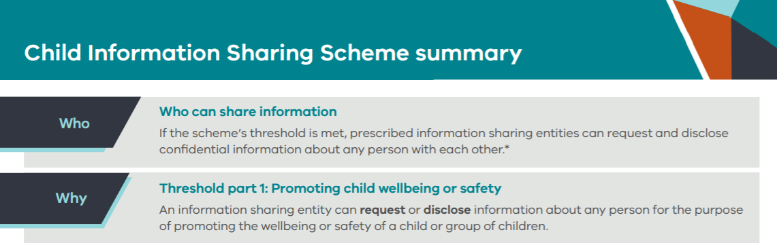
General resources
Session 2
Some additional resources are provided below. Try and familiarise yourself with them, so that you are aware of what additional information exists to support you as you adapt to the Family Violence Information Sharing Scheme.
Info
Resource name:
Tips for a conversation with a child and/or their parent about information sharing
How it helps: A helpful tip sheet that provides prompts and ideas about things to discuss with your clients about why information sharing is important and what it means for them.
Location: https://www.vic.gov.au/sites/default/files/2020-02/Tips-for-a-conversation-with-a-child-or-parent-about-information-sharing.pdf
Resource name:
Child Information Sharing Scheme summary
How it helps: A simple one-page summary of the Child Information Sharing Scheme, including who should share, why they share information, what information can be shared, when information should be shared and the principles of Child Information Sharing.
Location: https://www.vic.gov.au/sites/default/files/2019-01/Child%20Information%20Sharing%20Scheme%20on%20a%20page.pdf

